Slide 1

Part - III Principles of Electronic Communication
Chapter- 9: Communication Networks
Reference:
Garcia and Widjaja, “Communication
Networks”, McGraw Hill, 2006

Slide 2

Module I Introduction to Communication Networks
Objectives:
To describe the principles of communication networks
List the different types of communication networks
To explain the ISO OSI architecture
Department of Electronics and Communication Engineering, MIT, Manipal

Slide 3
Communication Networks
Introduction to Data Communication
Multiplexer
Multiple access
Source coding
Error detection and correction
Switching
Signaling
Notes:
Multiplexer: Combines the signals from different sources to transmit on the channel. At the receiving end, a demultiplexer is used to separate the signals.
Multiple access: When two or more users share the same channel, each user has to transmit his signal only at a specified time or using a specific frequency band.
Source coding: If the channel has a lower bandwidth than the input signal bandwidth, the input signal has to be processed to reduce its bandwidth so that it can be accommodated on the channel.
Error detection and correction: If the channel is noisy, the received data will have errors. Detection, and if possible correction, of the errors has to be done at the receiving end. This is done through a mechanism called channel coding.
Switching: If a large number of users has to be provided with communication facilities, as in a telephone network, the users are to be connected based on the numbers dialed. This is done through a mechanism called switching.
Signaling: In a telephone network, when you dial a particular telephone number, you are telling the network whom you want to call. This is called signaling information. The telephone switch (or exchange) will process the signaling information to carry out the necessary operations for connecting to the called party.

Slide 4
Communication Networks
Introduction to Communication Networks
Point-to-point communication
Point-to-multipoint communication
Broadcasting
Department of Electronics and Communication Engineering, MIT, Manipal
Notes:
Point-to-point communication: In this type, communication takes place between two end points. For instance, in the case of voice communication using telephones, there is one calling party and one called party. Hence the communication is point-to-point.
Point-to-multipoint communication: In this type of communication, there is one sender and multiple recipients. For example, in voice conferencing, one person will be talking but many others can listen. The message from the sender has to be multicast to many others.
Broadcasting: In a broadcasting system, there is a central location from which information is sent to many recipients, as in the case of audio or video broadcasting. In a broadcasting system, the listeners are passive, and there is no reverse communication path.

Slide 5
Network switching
Three types of switching techniques are
Circuit switching
Message switching
Packet switching
Notes:
a. Circuit switching: In circuit switching, to transfer the data circuit must be established so that the data transfer can take place. Applications which use circuit switching may have to go through three phases:
Establish a circuit
Transfer of data
Disconnect the circuit
Example : Telephone networks
b. Message switching: In message switching data is routed in its entirety from source to the destination, one hop at a time.
Example: Telegraph, Military applications
c. Packet switching: In packet switching the entire message is broken down into smaller chunks called packets. The switching information is added in the header of each packet and transmitted independently. The main advantage of packet switching is that each packet can take a different route to reach the destination, and it is not necessary that all packets follow the same route. If one communication link fails, packets can take a different route; if one communication link has too much traffic, the packets can take a route with less traffic.
Example: Internet

Slide 6
Communication Networks
Types of communication networks
Local Area Network(LAN)
Wide Area Network(WAN)
Metropolitan Area Network(MAN)
Public Switched Network
Wireless Network
Satellite Network
Notes:
Local Area Network(LAN)
A local area network is a network of computers in a localized area, such as in an office or a school. All the computers are connected to each other through the LAN via a hub or a switch.
Wide Area Network(WAN)
A wide-area network covers a large geographical area and usually consists of multiple computer networks. The Internet is a WAN which relies on a large global network of service providers who use routers, switches, modems and servers to provide connectivity to people and organizations around the world.
Metropolitan Area Network (MAN)
A metropolitan area network is a larger network that usually spans several buildings in the same city or town. It is larger than a LAN but smaller than a WAN. A MAN is typically owned and operated by a single entity such as a government body or large corporation.
Public Switched Network
The public switched network is essentially the telephones' version of the Internet. It is a network of public circuit-switched telephones. The network today is largely digital and includes services for both cellular and landline phones.
Wireless Networks
Wireless networks provided information transmission and network connectivity to devices without cables or wires. Wi-Fi is a wireless network for computers, which can access the network remotely. Bluetooth, which connects with a nearby mobile phone, is a shorter-range version of a wireless network, which supports transmission of voice and data but only at a distance of a few feet from the communication device with which it works.
Satellite Networks
Satellite networks come in a number of different varieties. Phone companies use satellites for data and voice transmission to mobile phones on the ground. Some satellite networks provide navigation information(e.g.: GPS-Global Positioning System), military surveillance or weather data. Still others provide television programming, radio broadcasts and even broadband Internet service.

Slide 7
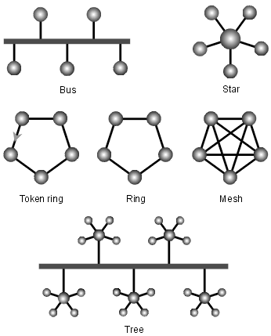
Network topology
Notes:
Network topology: In communication networks, a topology is a usually schematic description of the arrangement of a network, including its nodes and connecting lines. There are two ways of defining network geometry: the physical topology and the logical (or signal) topology.
The physical topology of a network is the actual geometric layout of workstations.
In the bus network topology, every workstation is connected to a main cable called the bus. Therefore, in effect, each workstation is directly connected to every other workstation in the network.
In the star network topology, there is a central computer or server to which all the workstations are directly connected. Every workstation is indirectly connected to every other through the central computer.
In the ring network topology, the workstations are connected in a closed loop configuration. Adjacent pairs of workstations are directly connected. Other pairs of workstations are indirectly connected, the data passing through one or more intermediate nodes.
If a token ring protocol is used in a star or ring topology, the signal travels in only one direction, carried by a so-called token from node to node.
The mesh network topology employs either of two schemes, called full mesh and partial mesh. In the full mesh topology, each workstation is connected directly to each of the others. In the partial mesh topology, some workstations are connected to all the others, and some are connected only to those other nodes with which they exchange the most data.
The tree network topology uses two or more star networks connected together. The central computers of the star networks are connected to a main bus. Thus, a tree network is a bus network of star networks.

Slide 8
Network protocols
Network protocols define rules and conventions for communication between network devices
Notes:
e.g:
DNS –Domain Name System
FTP –File Transfer Protocol
HTTP- Hypertext Transfer Protocol
TCP and UDP- Transmission Control Protocol and User Datagram Protocol
SMTP- Simple Mail Transfer Protocol
IP and Ipv6- Internet Protocol and Internet Protocol version 6

Slide 9
Need for layered approach
Every layer will perform well-defined, specific functions
Modifications in one layer's functionality or implementation does not affect the other layer
A layer can be divided into sub-layers
A layer can be eliminated or by-passed
This multi-vendor approach benefits the end user

Slide 10
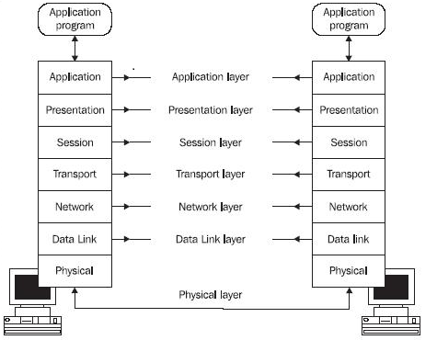
Seven-layer architecture of ISO OSI
Notes:
Each layer performs a specific set of functions. Each protocol layer adds a header and passes the packet to the layer below. Because the header is interpreted only by the corresponding layer in the receiving system, the communication is called peer-to-peer communication. Peer means a layer at the same level.
Physical layer: The physical layer specifies the physical interface between devices. This layer describes the mechanical, electrical, functional, and procedural characteristics of the interface.
An example of the physical layer is Electronic Industries Association (EIA) RS232, which specifies the serial communication interface. We connect a modem to the PC through the RS232 interface.
Data link layer: The data link layer's job is to activate the link, maintain the link for data transfer and deactivate the link after the data transfer is complete. Error detection and control, and flow control are also done by the data link layer.
Network Layer: The important function of the network layer is to relieve the higher layers of the need to know anything about the underlying transmission and switching technologies. The functions of the network layer are:
Switching and routing of packets
Management of multiple data links
Negotiating with the network for priority and destination address

Slide 11
Summary
In this module we have learnt:
Key terms used in communication networks such as multiplexing, multiple access, source coding, error detection and correction, switching and signaling.
Concept of point-to-point communication, point-to-multipoint communication and broadcasting.
Different types of network switching techniques such as circuit switching, message switching and packet switching.
Different forms of networks such as local area network, wide area network, metropolitan network, public switch network, wireless networks, satellite networks
Network topology such as bus, star, ring, token ring, mesh and tree.
Network protocols and need for layered approach.
To draw the seven layer architecture of ISO OSI model and need for each layer.

Slide 12
Self Test
List the different networks used for communication.
Draw the various topology used in communication networks.
Define protocol and explain the need for network protocols.
For N devices in a network, what is the number of cable links necessary for mesh, ring, bus and star networks.

Slide 13
Exercises
Compare circuit switching and message switching with packet switching.
Give an advantage for each type of network topology.
What is LAN, WAN and MAN? Give one example for each.

